Slide 1


Administrative Slide
If you see ,it means the slide is paused.
You will need to manually advance the slide.
(click the mouse, press the Enter key, Page Down or press the down arrow)
The right facing arrow ( ) will indicate your next starting point (after a pause.)
When the picture appears at the bottom left of the page, you are at the end of that slide. The next click will move to the next slide
a
a

Slide 2


Scorer Clinic
https://lsvolleyball.org
Rev. 12/17/25

Slide 3

Be Courteous to Others
People Are Here to Learn
Please:
    Turn off cell phones. (Off, Airplane Mode or Silent)
    Pay attention.
      Everyone can learn something new.
      Do not distract those who are here to learn.
    Keep conversations to clinic related topics.
If you have a question, ask it:
  Relevant questions are great!
  The person next to you probably has the same question.

Slide 4

Remember:
Scorer Certification Requirements
Register In the Lone Star Region (USA Volleyball Membership in Sports Engine)
Submit application – (pre-register online or at a clinic)
Attend clinic
Take and correct exam
Receive a passing evaluation on score sheets from two sets,
at a live match where you are the scorer.
(submissions may be electronic - email to: LSScorechair@gmail.com)
The absolute FINAL date for submission of score sheets is 8/31/26!
Pay applicable fees
* * A COMPLETED certification is good for two seasons. * *
* Remember: It is your responsibility to submit score sheets from two sets. *

Slide 5
Lone Star Region
Contacts
Mail your completed
score sheets here!
(email or Paper)
Commissioner
Scorer Chair
Referee Chair
Will Vick
1608 Canyon Oak
Shertz, TX 77154
willvick@satx.rr.com
210.945.4365
Joe Campbell
5110 Binion Forest Lane
Spring, TX. 77389
LSRscorechair@gmail.com
Joe Lizama
3733 Morgan Mill Rd.
Kempner, TX 76539
LSRrefereechair@gmail.com
Area Representatives
Austin
Brazos Valley
Corpus Christi
Urissa Stephens
urissa@austinjuniors.com
512-433-5142
Wally Simpson
w-simpson@cox-internet.com
979.696.0611
Dawna Nims
iteachvball@gmail.com
361-728-3487
Golden Triangle
Houston
San Antonio
Shereka McLain
Fmtvachiefs@gmail.com
C: 409-350-5413
Tiffany Wisdom
tiffanywisdom@gmail.com
832-687-9547
Renee Keller
renee.keller3@gmail.com
210-343-9120

Slide 6

Information
All materials and this presentation are available for download at:
https://lsvolleyball.org,
click on Reference, Scorer Summaries & Tips
All Score Sheets, line-up sheets and Libero Control sheets are available for download at:
https://lsvolleyball.org,
click on Reference, USAV Score Sheets

Slide 7

Question ‘Spot’
Any questions or comments on Requirements for Certification?

Slide 8
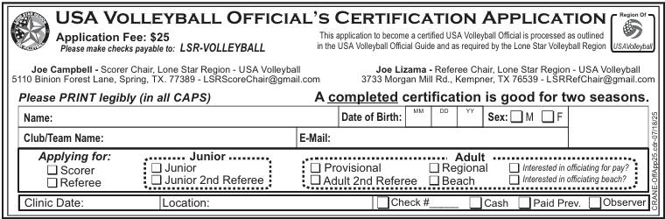
Application
If you did not pre-register online, fill out application at the beginning of the clinic.
Turn in your application, your corrected test, and your fees at the end - TOGETHER.
If you pay by check, please make
the check to: LSR-VOLLEYBALL.

Slide 9
Officials and Work Team
Common Placement
R1
L1
R1 – 1st Referee
R2 – 2nd Referee
S – Scorer
AS – Assistant Scorer
(Libero Control)
VS – Visual Scorer
(Scoreboard Operator)
L1/L3 – Line Judges
For Juniors, Coach must be courtside
L3
R2
Team Bench
VS
AS
S
Team Bench
Notes:
Linesperson count starts from right of R1 – L1, L2, L3, L4 being to the left of R1.

Slide 10

Materials Needed to Keep Score
1-two set sheet or 2 non-deciding set score sheets
Deciding set score sheet if required
2 line-up sheets
Libero Control sheet
Visual Scoreboard
Pen (black or blue ink), pencils and eraser
Correction tape (for the daring who only use ink)
Straight edge (ruler) - for T-Bar through unused points
A timing device (watch, clock, etc.)
- to enter Start and End times
1-6 will usually be provided by the tournament host
6-9 are your responsibility.

Slide 11
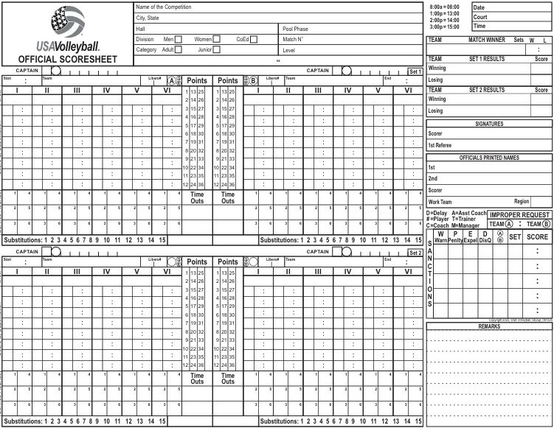
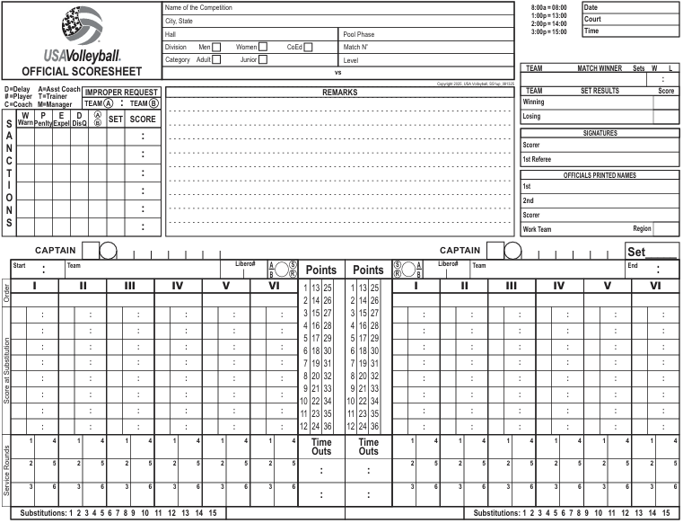
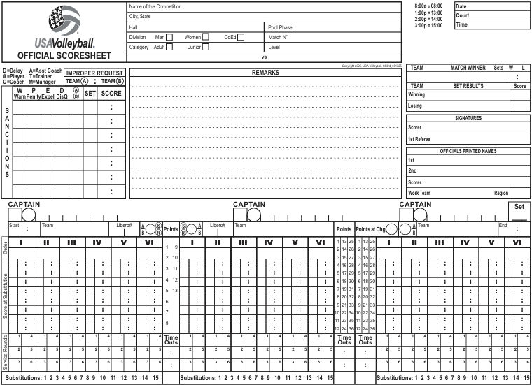
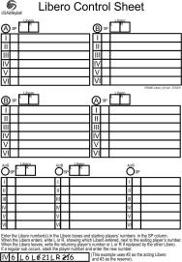
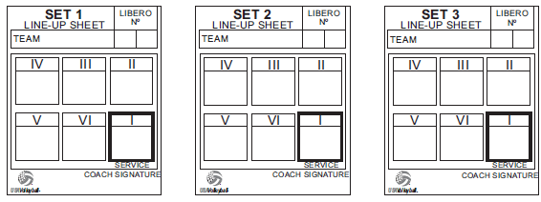
Non-Deciding set score sheet
Two set score sheet
Line-up sheet for each team
Deciding set score sheet
Libero Control sheet

Slide 12

Parts of the score sheet
HEADING (Pen)
HEADING (Pen)
RESULTS (Pen)
SANCTIONS
REMARKS
Signatures (Pen)
OFFICIALS SECTION (Pen)
Captain Tracking
Captain Tracking
TIME AND TEAM INFORMATION (Pen)
Points
Columns
TIME AND TEAM INFORMATION (Pen)
Line up (Pen)
Line up (Pen)
Score at Substitution
Section
Score at Substitution
Section
Service Round
Section
Time
Outs
Service Round
Section
Total Team Substitutions

Slide 13
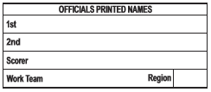
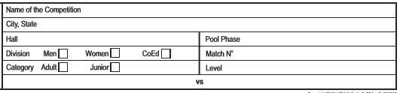
Beginning the score sheet
As soon as you have completed playing your match and it is your turn to officiate get your pens, pencils, timer, eraser and correction tape
Start the Heading and Officials sections of the score sheet while you are waiting for the results of the coin toss at the captain’s meeting

Slide 14

Get out your Non-Deciding score sheet
and follow along as we go through how to keep score!

Slide 15
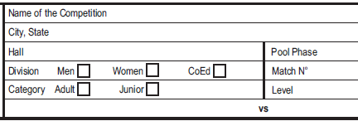


Heading and Officials Sections
Using Pen And CAPITAL LETTERS
Enter Heading Information
REGIONAL CHAMPIONSHIP
HOUSTON, TX
CONV CENTER
COUGARS VS OWLS
Make sure you complete all Division, Court and Match information for accurate posting of results
For the Date use: MM/DD/YY (05/02/26)
For the Time use International Time (hhmm):
8:00 AM would be 08:00
2:00 PM would be 14:00
GIRLS
JUNIOR
POOL B - MATCH 8
17’s
MAY 2, 2026 (05/02/26)
COURT 2
MATCH TIME 2:00 PM (14:00)
REGIONAL CHAMPIONSHIP
SET 1
HOUSTON, TX
At some tournaments, this may be pre-printed on the score sheet.
CONV CENTER
B
X
8
05/02/26
X
17
2
COUGARS OWLS
14:00
1
(Top Center)
(Top Right)
(Middle Right)
Time is expressed in International format
(We will discuss this more later)

Slide 16
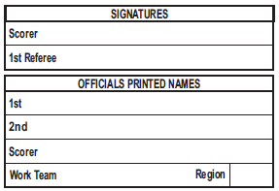
Using Pen And CAPITAL LETTERS
Enter Officials LAST NAME, FIRST NAME
(Middle Right on Score Sheet)
1st Referee: SAM GOODE
2nd Referee: JESSE SMART
Scorer: YOUR NAME
Work Team: YOUR TEAM/CLUB
Region: LS (Lone Star)
[This is the home Region of the Work Team]
Do Not sign until end of set
GOODE, SAM
SMART, JESSE
NAME, YOUR
YOUR TEAM/CLUB
LS

Slide 17
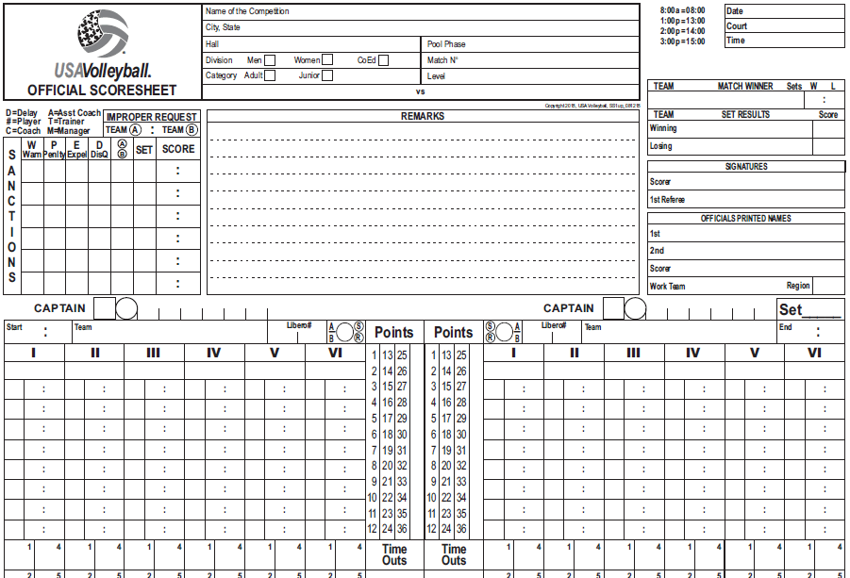
Results of
the Coin Toss
REGIONAL CHAMPIONSHIP
05/02/26
HOUSTON, TX
2
CONV CENTER
B
14:00
Enter the Team Information in Pen and CAPITAL LETTERS.
COUGARS serving on the left.
Put an A in the circle. Cougars will be Team A for the whole match.
X the service circle,
OWLS receiving on the right. Put a B in the circle. Owls will be Team B for the match.
X the receive circle and X the first service round box in the receiving teams’ column I.
Since this tournament does not supply Rosters, place an X in the Captain square
(we will talk more about this procedure in a minute)
X
8
X
17
COUGARS
OWLS
X
X
X
COUGARS
A
B
OWLS
X
X

Slide 18
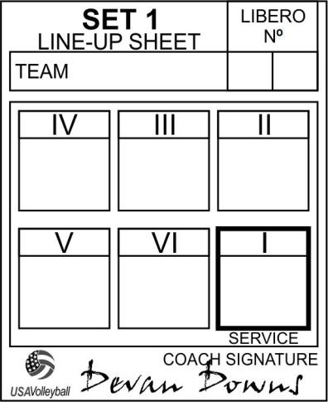
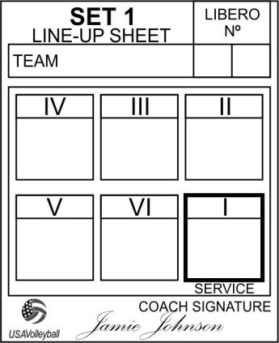
Line-up SHEETS
LIBERO NUMBERS
X
COUGARS
15 9
OWLS
X
FLOOR
CAPTAIN
8
6c
4
7
5
3c
COACH’S SIGNATURE
10
12
2
9
11
1
Once the line-up is signed and received it may not be changed, unless a regular substitution is made
Look for a Libero number when the line-up is received so it may be added if the coach forgot
The coach must fill out the line-up for each set
(Do Not just use the 1st set line-up for the 2nd set)
Line-ups may not be shared with the opposing team/coach

Slide 19

Captain Designation
The score sheet includes an area to track the captains.
If the tournament provides rosters, then the uniform number of the person designated captain on the roster is placed in the square.
(this person will always be captain when on the court)
If there are no rosters, place an X in the square.
X
6
If the libero is designated as floor captain, it is recommended the coach designate an alternate captain on the line-up sheet.
X
COUGARS
15 9c
9
6
This entry shows that there is no roster captain,
9 is the captain whenever they are on the court and 6 is the captain when 9 is off the court.
8
6a
4
10
12
2
If neither player is on the court, then another alternate must be designated. Advise the R2 and they will get the assignment from the coach.
This is the entry on the score sheet:
X
8
9
6
/
NOTE: When 6 returns to the court, 8 remains the floor captain.

Slide 20
REGIONAL CHAMPIONSHIP
05/02/26
Enter Team Line-ups
2
HOUSTON, TX
14:00
CONV CENTER
B
X
8
X
17
COUGARS
OWLS
GOODE, SAM
SMART, JESSE
Enter the numbers in the center of the space provided
NAME, YOUR
YOUR TEAM LS
X
6
X
3
1
X
COUGARS
15 9
A
B
X X
OWLS
X
2
4
6
8
10
12
1
3
5
7
9
11
X
Cougars
15 9
Owls
X
8
6c
4
7
5
3c
10
12
2
9
11
1
X

Slide 21
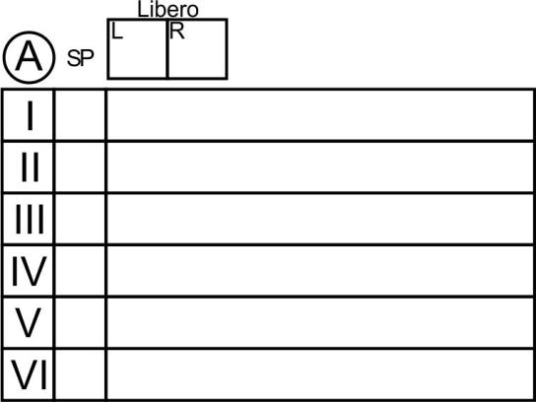
Give the line-up to the Assistant Scorer to enter on the Libero Control Sheet
15
COUGARS
9
2
4
Cougars
15
9
6
8
8
6c
4
10
12
10
12
2
We will cover Libero Control
in more detail later.

Slide 22
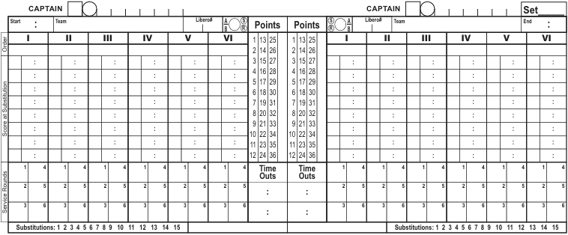
2ND Referee & Scorer DOUBLE CHECK
that the line-up is Entered CORRECTLY
X
6
X
3
1
X
B
OWLS
COUGARS
15 9
A
X
X
X
2
4
6
8
10
12
1
3
5
7
9
11
After entering the line-ups on the score sheet
  The second referee should verify that you have written them correctly
  Then the second referee takes the line-up sheets and checks the player positions on the floor
  The scorer should check the line-ups at the same time to be sure they are entered correctly and the players are in the correct positions on the court

Slide 23
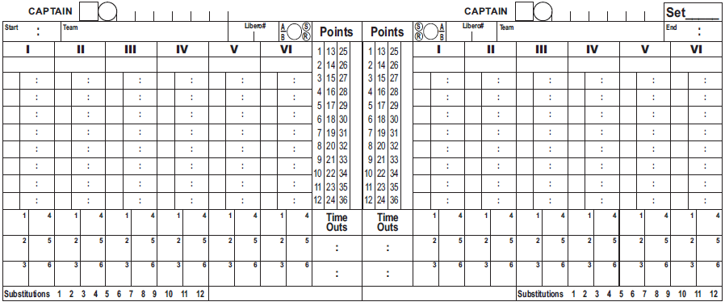
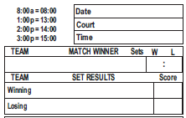
Entering Start Time
Remember: you have a built in Cheat-Sheet
X
6
X
3
1
X
14 14
COUGARS
15 9
A
B
X
X
OWLS
X
2
4
6
8
10
12
1
3
5
7
9
11
Upper Right Corner of Score Sheet
X
The starting time for the set is when the first referee beckons for service
The time is entered in Pen
Use International time. Ex: 2 PM = 14:00
The set starts at 2:14 PM. Enter the start time as 14:14

Slide 24
Question ‘Spot’
Any questions or comments on completing the Headings or Team Information?

Slide 25

Scoring the Set
ü
ü(check) the number in the upper right corner of Service Rounds box for each correct server when they CONTACT the ball for service
If it is the wrong server- DO NOT ü the number in the service round box.
  Only enter the Exit Score (total team score)
  Do not notify the 2nd Referee until after the wrong server has contacted the ball
DO NOT ü the Service Rounds box if the server fails to serve in the allotted time and a loss of rally is issued without contact of the ball
DO NOT ü the Service Rounds box if a Server tosses a ball and lets it drop. Note: For 14 and under if the server tosses the ball and then catches it or allows it to fall to the floor, this is considered a service tossing error, including a ball that touches the server as it falls.
DO NOT ü the Service Rounds box if the last point of the set is scored on a loss of rally. Just enter the set point as the exit score for the next server
For the first rotation ü boxes with the number 1.
For the second rotation ü boxes with the number 2 and so on.
Notes:
15 and older are allowed 8 seconds to serve the ball
14 and under are only allowed 5 seconds to serve the ball

Slide 26
Checking the Service Round Box.
X
6
X
3
1
X
14 14
COUGARS
15
9
A
B
X
X
OWLS
X
2
4
6
8
10
12
1
3
5
7
9
11
ü
X
Once the set begins you may use Pen or Pencil.
the number in the Service Rounds box when Cougars #2 (the first server) legally contacts the ball
Do Not ü before they contact the ball.
Make a small ü that only covers the number.
X

Slide 27
Scoring the Set
X
6
X
3
1
X
14 14
COUGARS
15
9
A
B
X
X
OWLS
X
2
4
6
8
10
12
1
3
5
7
9
11
ü
X
0
Cougars serve the ball out. This ends the Cougars term of service.
Enter the EXIT SCORE- (The total team score at the end of the service) in the Service Rounds box. Cougars have 0 points.
Now slash the loss of rally point for Owls in their Points column.

Slide 28
Scoring the Set
X
6
X
3
1
X
14 14
COUGARS
15
A
B
X
X
OWLS
9
X
2
4
6
8
10
12
1
3
5
7
9
11
ü
ü
0
X
3
The first server for Owls is # 3. After they contact the ball for service ü the Service Rounds box.
Owls #3 scores with an Ace. Slash Point 2.
Owls #3 serves and scores another point. Slash point 3.
#3 then commits a Foot Fault while serving.
No additional information needs to be recorded for a Foot Fault.
Since the Foot Fault is the end of #3’s service enter the Exit Score of 3.
Now slash the loss of rally point for Cougars in their Points column.
X

Slide 29
Scoring the Set
X
6
X
3
1
X
14 14
COUGARS
15
A
B
X
X
9
X
OWLS
2
4
6
8
10
12
1
3
5
7
9
11
ü
ü
X
ü
0
5
3
Cougars #15 (Libero) enters to serve for #4.
Cougars #15 serves the ball (ü the Service Rounds box and triangle II)
and scores a point. Triangle point 2
Cougars #15 serves and wins three more points. Triangle points 3, 4 and 5
Cougars #15 serves the ball into the net. Enter the Exit Score of 5
Now slash the loss of rally point for Owls in their Points column.
X
a
29

Slide 30

Scoring the Set
X
6
X
3
1
X
14 14
COUGARS
15
9
A
B
X
X
OWLS
X
During time outs, check that the visual score is correct
Check that the number of substitutions matches the total team subs and that the Score at Substitution entries are complete
The Assistant Scorer communicates (verbally or hand signals) with the Second Referee indicating which Libero is on or off the court. When the teams return check that there was no illegal Libero entry or exit
At the end of the time-out, signal to the Referees how many time outs have been taken by each team.
2
4
6
8
10
12
1
3
5
7
9
11
Each team gets only 2 time outs per set. No additional team time outs are ever awarded in USAV play
Time-outs in USAV are 30 seconds long
ü
ü
X
ü
ü
0
5
3
9
5
8
Owls #5 serves the ball (ü the Service Rounds box)
and scores a point. Slash point 5
Owls #5 serves and their team wins three more points. Slash points 6, 7 and 8
The coach for the Cougars calls for and is granted a time out.
Enter the score for each team in the Time Outs box, requesting team first.
When you have completed your entries, hold your arms up with palms facing out to show you are ready
Owls #5 serves an ace. Slash point 9
Owls #5 then serves the ball out. Enter the Exit Score of 9
Next slash the loss of rally point in the Cougars Points column.
X
a
a
30

Slide 31
Scoring the Set
X
6
X
3
1
X
14 14
COUGARS
15
9
A
B
X
X
OWLS
Each team gets 15 Team Substitutions
There is no limit to the number of individual substitutions
Once a player is listed in a Service Order column, they may not substitute in any other position, unless there is an Exceptional Substitution
More than 2 players may be in the same Service Order column
When a team reaches 12 substitutions, notify the R2
X
2
4
6
8
10
12
1
3
5
7
9
11
9
8
13
ü
ü
ü
X
ü
ü
0
5
10
3
9
5
8
Cougars #6 serves the ball (ü the Service Rounds box), and scores a point. Slash point 7
Cougars #6 serves and wins an additional point. Slash point 8
The Owls substitute #13 for #5. In the Score at Substitution section, enter #13, then
enter the score for each team, substituting team first.
Then slash the number in the Substitutions section.
When you have completed your entries, hold your arms up with palms facing out to show you are ready
Cougars #6 serves two more points. Slash points 9 and 10.
Cougars #6 then serves the ball into the net. Enter the Exit Score of 10,
Next slash the loss of rally point for Owls in their Points column.
X
a
a
31

Slide 32
Scoring the Set
X
6
X
3
1
X
14 14
COUGARS
15
9
A
B
X
X
OWLS
X
2
4
6
8
10
12
1
3
5
7
9
11
9
8
14
10
13
14
ü
ü
ü
X
ü
ü
ü
0
5
10
3
9
15
5
8
Owls #7 serves the ball (ü the Service Rounds box), and scores a point. Slash point 11
Owls #7 serves and wins three additional points. Slash points 12, 13 & 14
The Cougars substitute #14 for #8. In the Score at Substitution section, enter #14,
then enter the score for each team, substituting team first.
Finally, slash the number in the Substitutions section.
Owls #7 serves one more point, then serves the ball out.
Slash point 15 then enter the Exit Score of 15
Next slash the loss of rally point for Cougars in their Points column.
X
a
32

Slide 33
Scoring the Set
X
6
X
3
1
X
14 14
COUGARS
15
9
A
B
X
X
OWLS
X
2
4
6
8
10
12
1
3
5
7
9
11
14
13
14
9
8
10
ü
ü
ü
ü
X
ü
ü
ü
0
5
10
3
9
15
5
8
Cougars #14 serves the ball (ü the Service Rounds box) and scores a point. Slash point 12
Cougars #14 serves and wins another point. Slash point 13
After the referee blows the whistle and signals for serve, Owls coach requests a time out.
The referee denies the request and allows the rally to continue.
Cougars win the rally. Slash point 14
X
33

Slide 34
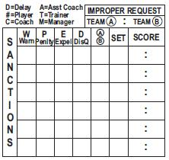
Scoring the Set
X
6
X
3
1
X
14 14
COUGARS
15
9
A
B
X
X
OWLS
X
2
4
6
8
10
12
1
3
5
7
9
11
14
9
8
14
13
10
Sanctions are cumulative over the entire match
Re-enter them on any additional score sheets
(like a deciding set)
ü
ü
ü
ü
X
ü
ü
ü
0
5
10
15
3
9
15
5
8
At the end of the rally, R2 tells you “Improper Request on the Owls” (Team B).
In the IMPROPER REQUEST box place an X through the circled B.
Cougars #14 serves one more point, then serves the ball out.
Slash point 15 then enter the Exit Score of 15
Next slash the loss of rally point for the Owls in their Points column.
X
X
a
34

Slide 35
Scoring the Set
X
6
X
3
1
X
14 14
COUGARS
15
9
A
B
X
X
OWLS
X
2
4
6
8
10
12
1
3
5
7
9
11
14
13
10
9
8
14
ü
ü
ü
ü
X
ü
ü
ü
0
5
10
15
3
9
15
16
5
8
Owls #11 serves the ball.
#9 should have served the ball, so that is an incorrect server.
Notify the R2 as soon as the player contacts the ball for service.
Do not enter a check (the correct player did not contact the ball for service), just enter the Exit Score of 16.
Next slash the loss of rally point for Cougars in their Points column.
No additional information needs to be recorded for a Wrong Server.
X
35

Slide 36
Scoring the Set
X
6
X
3
1
X
14 14
COUGARS
15
9
A
B
X
X
OWLS
X
2
4
6
8
10
12
1
3
5
7
9
11
9
14
10
13
8
14
8
16
21
ü
ü
ü
ü
ü
X
ü
ü
ü
ü
0
5
10
15
16
3
9
15
16
22
5
8
X
Cougars #10 serves the ball (ü the Service Rounds box), and the ball goes out.
Enter Exit Score of 16 and slash the loss of rally point for Owls in their Points column.
Owls #11 serves the ball (ü the Service Rounds box), and scores a point. Then scores 3 more points.
The Cougars substitute #8 for #14. In the Score at Substitution section, enter #8
then enter the score for each team, substituting team first.
Finally, slash the next number in the Substitutions section
Owls #11 wins one more point, then loses the next rally.
Slash Owls next point, enter exit score and slash loss of rally point for the Cougars
a
a
36

Slide 37

Scoring the Set
X
6
X
3
1
X
14 14
COUGARS
15
9
A
B
X
X
OWLS
X
2
4
6
8
10
12
1
3
5
7
9
11
9
8
14
10
13
14
8
21
16
Reminder: Sanctions are cumulative over the entire match
Re-enter them on any additional score sheets
(like a deciding set)
Note: Yellow card warnings are assessed to individuals,
but are in force for the entire team. This means that each
team may only receive one yellow card per match.
ü
ü
ü
ü
ü
ü
ü
X
ü
ü
ü
0
5
10
15
16
19
3
9
15
16
22
Let’s try a few on your own!
5
8
22
19
Cougars #12 serves the ball, and scores a point.
#12 serves and wins an additional point.
The captain for the Owls calls a time out.
Owls #11 yells at an opposing player.
R1 holds up a yellow card and points at Owls #11.
In the SANCTIONS box make the following entry:
Warning on Player #11, Team B, Set 1, Score 22:19
Since this is only a warning, no other action is necessary
After entering the Sanction information provide the Ready signal
Cougars #12 serves the ball and loses the rally.
X
X
a
1
11
B
22 19
a
37

Slide 38

Scoring the Set
X
6
X
3
1
X
14 14
COUGARS
15
9
A
B
X
X
OWLS
X
2
4
6
8
10
12
1
3
5
7
9
11
9
8
14
10
13
14
8
16
21
ü
ü
ü
ü
ü
ü
X
ü
ü
ü
ü
0
5
10
15
16
19
3
9
15
16
22
ü
5
8
22
19
ü
21
23
Let’s try a few more on your own!
X
Owls #1 serves the ball into the net.
Cougars #2 serves and wins a point.
#2 serves and the Cougars lose the rally.
Notify R2 that it is set point for the Owls
Cougars #14 enters substitution zone with their warm-ups on.
R1 holds a yellow card against their wrist indicating a Team Delay Warning
In the SANCTIONS box make the following entry:
Under Warning enter a D, Team A, Set 1, Score 21:24
X
1
11
B
22 19
D
1
A
21 24
a
38

Slide 39

Scoring the Set
X
6
X
3
1
X
14 14
COUGARS
15
9
A
B
X
X
OWLS
X
2
4
6
8
10
12
1
3
5
7
9
11
9
8
14
10
13
14
8
16
21
ü
ü
ü
ü
ü
ü
X
ü
ü
ü
ü
0
5
10
15
16
19
3
9
15
16
22
ü
5
8
22
19
ü
21
23
24
X
Owls #11 yells at an opposing player using threatening language
R1 holds up a red card and points at Owls #11
In the SANCTIONS box make the following entry:
Under Penalty enter a 11, Team B, Set 1, Score 24:21
Since no serve occurred, enter the exit score of 24 with no check mark
In the Points column show the penalty by a slash and circle on point 22
X
1
11
B
22 19
D
1
A
21 24
11
1
B
24 21
39

Slide 40

Scoring the Set
X
6
X
3
1
X
14 14
COUGARS
15
9
A
B
X
X
OWLS
15 06
X
2
4
6
8
10
12
1
3
5
7
9
11
9
8
14
14
13
10
8
16
21
ü
ü
ü
ü
ü
ü
X
ü
ü
ü
ü
0
5
10
15
16
19
3
9
15
16
22
ü
ü
ü
Let’s try a couple more on your own!
21
23
5
8
22
19
23
24
25
Cougars #4 serves the ball and her team wins the point.
Cougars #4 serves again, but her team loses the rally.
Owls won the set on a side-out.
No check is entered in the Service Rounds section for #13, only the exit score showing set point
Switch to PEN to complete the remainder of the score sheet. The set ends at 3:06pm. Enter the time in the END box (International time)
In the Service Rounds section Circle the last exit score for each team
In the Points column for each team, “T-Bar” any unused points.
A separate bar should be drawn for each column
The T should begin above the first number and end at the bottom of the column
X
A set is won by the first team who scores 25 points, with a 2 point lead
a
40

Slide 41
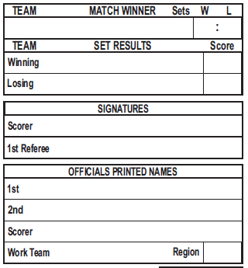
Scoring the Set
X
6
X
3
1
X
14 14
COUGARS
15
9
A
B
X
X
OWLS
15 06
X
2
4
6
8
10
12
1
3
5
7
9
11
9
8
14
10
13
14
8
16
21
The RESULTS section is on
the Right side of the Score Sheet
ü
ü
ü
ü
ü
ü
X
ü
ü
ü
ü
0
5
10
15
16
19
3
9
15
16
22
ü
ü
5
8
22
19
ü
ü
21
23
23
24
25
OWLS
25
COUGARS
23
Enter the Winning and Losing teams and scores in SET RESULTS
Check your score sheet for any oversights or errors
Sign in the space provided
YEA!!
You have successfully completed your score sheet!
Your Name
GOODE, SAM
SMART, JESSE
NAME, YOUR
YOUR TEAM
LS
41

Slide 42
Question ‘Spot’
Any questions or comments on Scoring the Set or Completing the Results?

Slide 43




Time for a
BREAK!
Be Back In
1
0
0
5
4
3
2
1
0
0
9
8
7
6
5
4
3
2
1
0
9
8
7
6
5
4
3
2
1
0
9
8
7
6
5
4
3
2
1
0
9
8
7
6
5
4
3
2
1
0
9
8
7
6
5
4
3
2
1
0
9
8
7
6
5
4
3
2
1
0
0
0
0
9
Hours
Minutes
Seconds

Slide 44
Time for a
BREAK!
Be Back In
0
0
5
4
3
2
1
0
0
9
8
7
6
5
4
3
2
1
0
9
8
7
6
5
4
3
2
1
0
9
8
7
6
5
4
3
2
1
0
9
8
7
6
5
4
3
2
1
0
9
8
7
6
5
4
3
2
1
0
9
8
7
6
5
4
3
2
1
0
0
9
0
8
Hours
Minutes
Seconds

Slide 45
Time for a
BREAK!
Be Back In
0
0
5
4
3
2
1
0
0
9
8
7
6
5
4
3
2
1
0
9
8
7
6
5
4
3
2
1
0
9
8
7
6
5
4
3
2
1
0
9
8
7
6
5
4
3
2
1
0
9
8
7
6
5
4
3
2
1
0
9
8
7
6
5
4
3
2
1
0
0
8
0
7
Hours
Minutes
Seconds

Slide 46
Time for a
BREAK!
Be Back In
0
0
5
4
3
2
1
0
0
9
8
7
6
5
4
3
2
1
0
9
8
7
6
5
4
3
2
1
0
9
8
7
6
5
4
3
2
1
0
9
8
7
6
5
4
3
2
1
0
9
8
7
6
5
4
3
2
1
0
9
8
7
6
5
4
3
2
1
0
0
7
0
6
Hours
Minutes
Seconds

Slide 47
Time for a
BREAK!
Be Back In
0
0
5
4
3
2
1
0
0
9
8
7
6
5
4
3
2
1
0
9
8
7
6
5
4
3
2
1
0
9
8
7
6
5
4
3
2
1
0
9
8
7
6
5
4
3
2
1
0
9
8
7
6
5
4
3
2
1
0
9
8
7
6
5
4
3
2
1
0
0
6
0
5
Hours
Minutes
Seconds

Slide 48
Time for a
BREAK!
Be Back In
0
0
5
4
3
2
1
0
0
9
8
7
6
5
4
3
2
1
0
9
8
7
6
5
4
3
2
1
0
9
8
7
6
5
4
3
2
1
0
9
8
7
6
5
4
3
2
1
0
9
8
7
6
5
4
3
2
1
0
9
8
7
6
5
4
3
2
1
0
0
5
0
4
Hours
Minutes
Seconds

Slide 49
Time for a
BREAK!
Be Back In
0
0
5
4
3
2
1
0
0
9
8
7
6
5
4
3
2
1
0
9
8
7
6
5
4
3
2
1
0
9
8
7
6
5
4
3
2
1
0
9
8
7
6
5
4
3
2
1
0
9
8
7
6
5
4
3
2
1
0
9
8
7
6
5
4
3
2
1
0
0
4
0
3
Hours
Minutes
Seconds

Slide 50
Time for a
BREAK!
Be Back In
0
0
5
4
3
2
1
0
0
9
8
7
6
5
4
3
2
1
0
9
8
7
6
5
4
3
2
1
0
9
8
7
6
5
4
3
2
1
0
9
8
7
6
5
4
3
2
1
0
9
8
7
6
5
4
3
2
1
0
9
8
7
6
5
4
3
2
1
0
0
3
0
2
Hours
Minutes
Seconds

Slide 51
Time for a
BREAK!
Be Back In
0
0
5
4
3
2
1
0
0
9
8
7
6
5
4
3
2
1
0
9
8
7
6
5
4
3
2
1
0
9
8
7
6
5
4
3
2
1
0
9
8
7
6
5
4
3
2
1
0
9
8
7
6
5
4
3
2
1
0
9
8
7
6
5
4
3
2
1
0
0
2
0
1
Hours
Minutes
Seconds

Slide 52
Time to be
BACK!
Be Back In
0
0
5
4
3
2
1
0
0
9
8
7
6
5
4
3
2
1
0
9
8
7
6
5
4
3
2
1
0
9
8
7
6
5
4
3
2
1
0
9
8
7
6
5
4
3
2
1
0
9
8
7
6
5
4
3
2
1
0
9
8
7
6
5
4
3
2
1
0
0
1
0
0
Hours
Minutes
Seconds

Slide 53
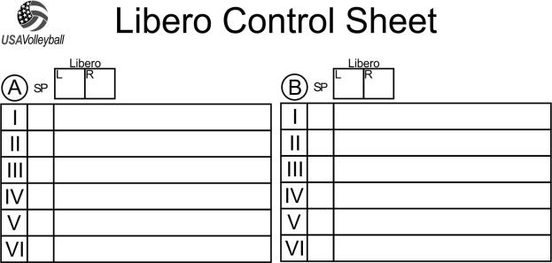
Rule on the LIBERO
Each team may designate zero, one or two Liberos in each set.
One Libero will be designated the Acting Libero by the coach
(L on the Libero Control Sheet)
The other Libero will be the second or Reserve Libero
(R on the Libero Control Sheet)
Only one Libero may be on the court at any time

Slide 54
Controlling the LIBERO
Assistant Scorer / Libero Control
should enter the line up of teams having a Libero
You may enter the team name here
15
9
COUGARS
2
4
Cougars
15
9
6
8
8
6c
4
10
12
10
12
2
It is not required to track the game captain or changes of the game captain
on the Libero Control Sheet.

Slide 55
Controlling the LIBERO
Cougars’ Libero replaces #12.
Write an L on the line next to player #12
15
9
COUGARS
2
4
6
8
10
12
L

Slide 56
Controlling the LIBERO
When the Libero leaves, the player whose # is before the L must replace the Libero.
Cougars’ #12 replaces the Libero. Write 12 next to the L.
The Libero Must sit out one completed Rally before re-entering the set.
The Assistant Scorer should check that the Libero DOES NOT play the front row.
15
9
COUGARS
2
4
6
8
10
12
L
12

Slide 57
Controlling the LIBERO
The Assistant Scorer must also track regular substitutions.
Cougars’ #18 replaces #12. Slash the 12 and write 18.
Remember that the Libero must always be replaced by the player whose number is listed before the L. A regular substitution may be made right away.
15
9
COUGARS
2
4
6
8
10
12
L
12
18

Slide 58
Controlling the LIBERO
When the Libero returns, enter an L next to the last number.
If the reserve Libero enters the set the active Libero must leave, enter R
Remember : there can only be one Libero on the floor at a time
15
9
COUGARS
2
4
6
8
10
12
L
12
18
L
R

Slide 59
Recording the LIBERO Serve
When the Libero enters the service position, enter an L next to the number.
When the Libero serves, triangle the Roman Numeral
Remember : The Libero may only serve from one position in the rotation.
Either Libero may serve from that position, but only one may be on the floor at a time.
15
9
COUGARS
2
L
4
6
8
At the end of each Time-Out, the Assistant Scorer should indicate the Libero status for each team by signaling “In” or “Out”.
Ex: If the libero for the team on the left is in and the team on the right is out you will extend your left hand, palm down and raise your right hand, palm toward you.
10
12
L
12
18
L
R
18

Slide 60
Question ‘Spot’
Any questions or comments regarding the Libero, or Libero Control Sheet?

Slide 61
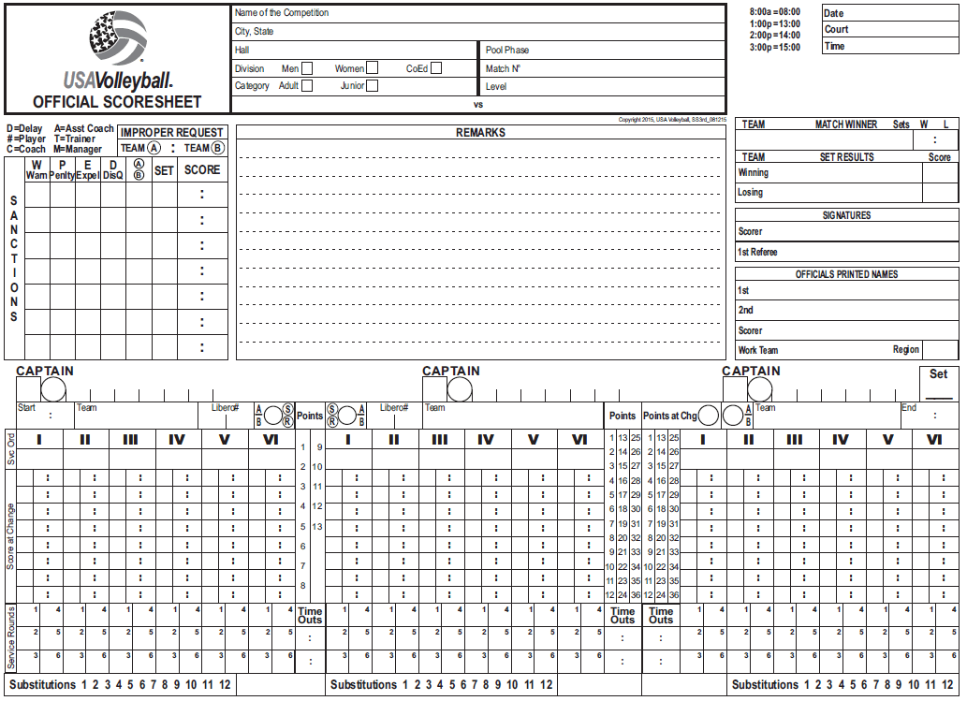
Deciding Set Score Sheet
This will most commonly be used in venues where there is an advantage for one side:
USAV 18.2.1: The default protocol is for each team to remain on their respective side of the court throughout the match, including the deciding set.
EXCEPTIONS:
  18.2.1.1 The event organizer determines there is a clear disadvantage on only one side of the court.
  18.2.1.1.1 In the case of a clear disadvantage, the decision to change courts will remain in effect

Slide 62
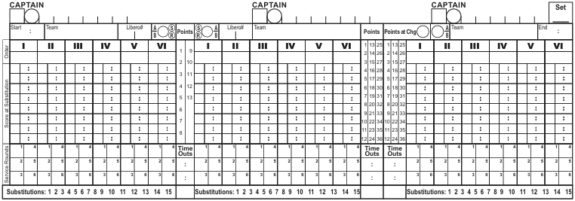
The Line Up for the team starting on
the left will also be entered on the far right
X
3
X
3
3
OWLS
x
x
B
x
A
B
OWLS
x
1
3
5
7
9
11
1
3
5
7
9
11
3
X
X
OWLS
X
7
5
3c
9
11
1

Slide 63
The Line Up for the team starting on
the right will be entered in the middle
X
3
X
6
X
3
3
OWLS
B
x
COUGARS
B
OWLS
x
x
x
A
15 9
1
3
5
7
9
11
2
4
6
8
10
12
1
3
5
7
9
11
X
3
Don’t forget, Sanctions are cumulative over the entire match
Re-enter them if you have an additional score sheet
(like a deciding set)
Cougars
15 9
8
6c
4
X
1
11
B
22 19
D
1
A
21 24
10
12
2
11
1
B
24 21

Slide 64

Using a Deciding Set Score Sheet for THE FIRST 8 OR 13 POINTS
For a Deciding set in a match the teams will switch sides when one team reaches 8 points.
Time-Outs and subs for the team starting on the
far left will also be recorded on the far right until the switch.
If the deciding set sheet is used for a 1 set playoff to 25 points the teams will switch sides at 13 points instead of 8 so you will use the left side until point 13

Slide 65
For the First 8 (13) Points
SUBSTITUTIONS and TIME OUTS
for the Team on the Left Are Also Recorded on the Far Right
X
3
X
6
X
3
7
7
3
B
x
OWLS
15 45
OWLS
x
x
x
A
15 9
COUGARS
B
/
/
1
3
5
7
9
11
2
4
6
8
10
12
/
1
3
5
7
9
11
/
18
/
5
22
0
5
0
22
0
/
/
0
/
/
/
/
/
/
/
/
X
ü
ü
ü
ü
ü
ü
4
5
4 5 7
0 4
0 4
/
/
/

Slide 66
If the team on the
Left scores the 8th point
Slash point 8 on the left, Record OWLS score (8) in the Points at Chg circle next to the team name on the far right and slash point 8 in the Points column on the right
Do Not enter exit score for OWLS #7, they are still serving.
Transfer the last Exit Score from the far left to the far right
When the Owls lose a point, the exit score will be recorded on the right side for OWLS #7
X
3
X
6
X
3
7
7
3
B
x
COUGARS
8
OWLS
15 45
OWLS
x
x
x
A
15 9
B
/
/
1
3
5
7
9
11
2
4
6
8
10
12
/
1
3
5
7
9
11
/
/
5
0
22
0
5
22
0
0
/
18
/
/
/
/
/
/
/
/
/
/
X
ü
ü
ü
ü
ü
ü
5
4
5
4 5 7
0 4
0 4
/
/
/
Next point scored by the OWLS will be recorded here

Slide 67
If the team on the
Right scores the 8th point
COUGARS win point 8 on a loss of rally.
Record OWLS score (7) in the Points at Chg circle
next to the team name on the far right.
Transfer the Owls’ last Service Rounds exit score
from the far left to the far right and slash the same point in the Points column.
X
7
X
6
X
3
3
7
3
OWLS
B
x
COUGARS
7
OWLS
15 45
x
x
x
A
15 9
B
/
/
1
3
5
7
9
11
2
4
6
8
10
12
/
1
3
5
7
9
11
/
/
0
18
0
5
22
0
5
22
0
/
/
/
/
/
/
/
/
/
/
/
X
ü
ü
ü
ü
ü
ü
4
5
7
4 5 7
7
0 4
0 4
/
/
/
Next point scored by the Owls will be recorded here

Slide 68
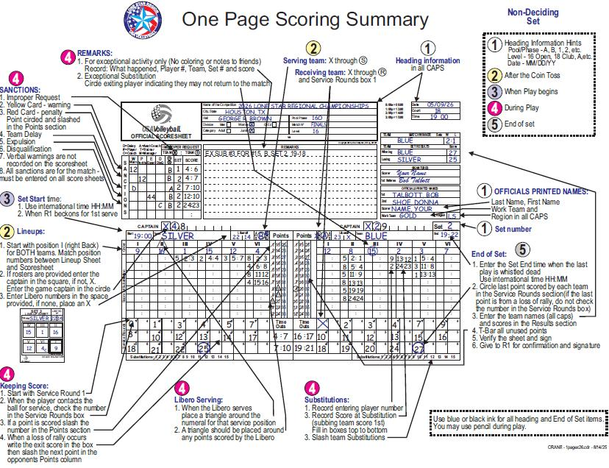
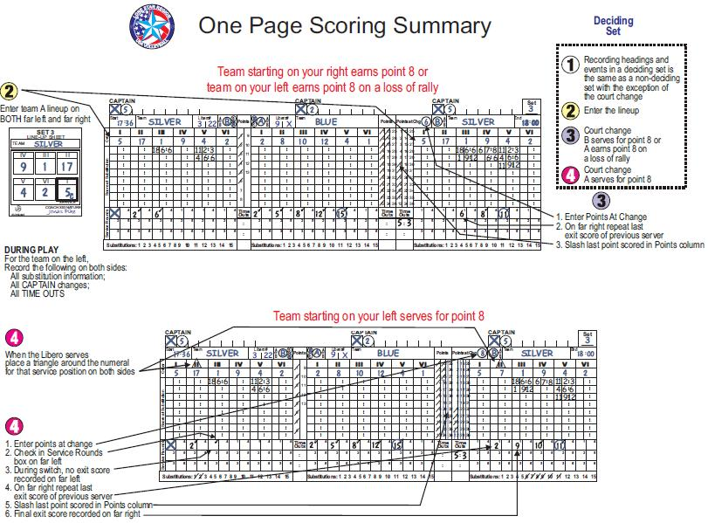
One Page Scoring Summary

Slide 69
Question ‘Spot’
Any questions or comments on the Deciding Set Score Sheet?

Slide 70
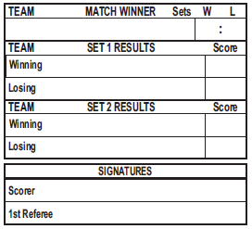
Post Match Procedures
At the completion of the match, record the match results in the MATCH WINNER box of all score sheets used.
Record the winning team name and number of sets won (W) and lost (L).
OWLS
2 0
OWLS
25
COUGARS
23
OWLS
25
COUGARS
19
Your Name
Check your score sheet for any oversights or errors
Be sure you have signed all score sheets
Give the score sheet to the R1 for their signature

Slide 71
Quick Reference on
Substitutions
THE FOUR ACTIONS FOR A SUBSTITUTION
In the Score at Substitution section, record the number of the entering player
Then write the score at the time of the substitution (Sub team score first)
Slash the team sub
Show the ready signal

Slide 72


Quick Reference on
Use of Pen & Pencil
Pen may be used for the whole score sheet if desired
Prior to the contact for the first serve use Pen for:
  Headings
  Officials Section
  Team Names
  3 “Xs” for S R X
  Line-ups
  Start Time
During set play Pencil
may be used for:
  Slashing points
  Exit scores
  Subs
  Time-outs
  Sanctions
  Remarks
After the last exit score is written switch to PEN for:
  End Time
  Circling final exit scores
  Results section
  T-Bar over un-used points
  Scorer signature
  R1 signature

Slide 73

Scorer Tips
If a Replay is awarded, the scorer records nothing on the score sheet (make sure the visual score is correct)
If A Mind Change occurs, (1st referee reverses a call) erase or use correction tape for any changes to the score sheet
If you make a mistake in the Pen sections and have no correction tape you may X out the mistake and write the correct information immediately following the X

Slide 74
Scorer Tips
The Receiving team always starts the 2nd round of service boxes first because they rotate into service.
X
6
X
3
1
X
14 14
COUGARS
15
A
B
X
X
OWLS
9
X
2
4
6
8
10
12
1
3
5
7
9
11
9
8
14
10
13
14
8
16
21
ü
ü
ü
ü
ü
ü
X
ü
ü
ü
ü
1
5
10
15
16
17
3
9
15
16
22
5
8
ü

Slide 75
Scorer Tips
Make sure at the beginning of each service that you have awarded the loss of rally point. NO TWO EXIT SCORES for one team should be the same - they will have earned a loss of rally point
Owls’ # 1 serves their first serve into the net
Should the Exit Score be 22?
No, the last exit score was 22
Side-out point 22 was missed in the Points column.
Slash 22 and 23 and enter the Exit score of 23
a
X
6
X
3
1
X
14 14
COUGARS
15
9
A
B
X
X
OWLS
X
2
4
6
8
10
12
1
3
5
7
9
11
9
8
14
10
13
14
8
16
21
ü
ü
ü
ü
ü
ü
X
ü
ü
ü
ü
1
5
10
15
16
17
3
9
15
16
22
5
8
ü
23

Slide 76
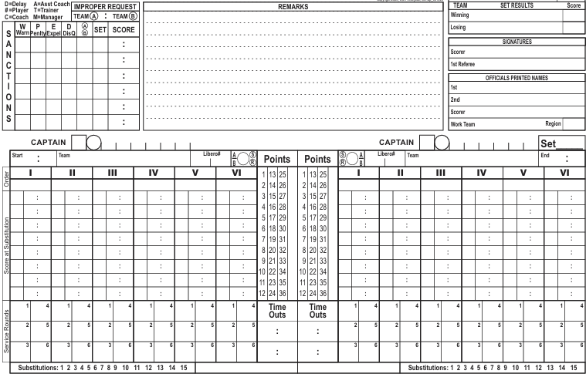
FORFEIT – before match begins
FORFEIT, B, SET 1, 0-0 NOT ENOUGH PLAYERS
COUGARS
25
OWLS
0
A FORFEIT may be caused by…
  an incomplete team at the beginning of set
  or a team that refuses to play
GOODE, SAM
SMART, JESSE
NAME, YOUR
YOUR TEAM
LS
X
6
X
3
1
08 00
COUGARS
15 9
A
X
X
B
X X
OWLS
08 00
2
4
6
8
10
12
1
3
5
7
9
11
All pre-set sections of score sheet should be completed
  - Heading, line-ups and Officials sections
Enter Remarks, what happened, team, set, score, why
Record Start & End Time
Write Forfeit across the score sheet
Write Winning & Losing team 25-0
Finish end of set procedures
NOTE:
  Do not T-Bar unused Points
  Do not circle any exit scores
FORFEIT
x

Slide 77
FORFEIT – during match
Another type of FORFEIT - is when a team cannot continue play after the set has started
FORFEIT, B, SET 1, 10-21, NOT ENOUGH PLAYERS DUE TO INJURY
COUGARS
25
OWLS
10
Record End Time
Enter Remarks, what happened, team, set, score, why
Slash & Circle points for opposing team up to 25
(or whatever is needed to win by 2 points)
Enter exit score of 25 for Cougars
Enter Winning & Losing team 25-10
(Forfeiting team retains all points earned)
Your Name
GOODE, SAM
SMART, JESSE
NAME, YOUR
YOUR TEAM
LS
X
6
X
3
1
X
OWLS
08 00
COUGARS
15 9
A
X
B
X X
08 20
2
4
6c
8
10
12
1
3c
5
7
9
11
x
P
P
P
P
P
P
P
P
P
P
4
10
15
19
25
0
2
5
7
10
NOTE: perform all normal post-set procedures
  Circle exit scores
  T-Bar unused Points
  Review, then sign score sheet

Slide 78
SANCTIONS BOX
On the upper left corner of the score sheet is the SANCTIONS box.
This box is used to record common penalties.

Slide 79
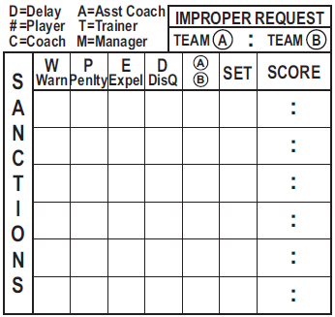
Types of Penalties in the Sanctions Box
IMPROPER REQUESTS
TEAM DELAY WARNINGS
TEAM DELAY PENALTIES
INDIVIDUAL PLAYER OR
TEAM STAFF WARNINGS
INDIVIDUAL PLAYER OR
TEAM STAFF PENALTIES
EXPULSION
DISQUALIFICATION
X
D
A
1
4
8
D
A
1
6
10
7
B
1
12
3
6
B
1
16
9
C
B
1
18
10
3
A
2
6
6
When there is an Expulsion or Disqualification the SANCTIONS entry is made, but no points are awarded
Since all Sanctions are for the Match, copy the entries to all set score sheets

Slide 80
Electronic Scoring Systems
(VolleyStation, VolleyWrite, eScore, etc.)
You may encounter an Electronic Scoring system
It is usually an app that runs on a phone or tablet
Lone Star Region Policy:
Tournaments must have the paper score sheets available during the event if a team chooses not to use the Electronic Scoring system.
If the parent of your scorer is comfortable downloading the app and the athlete is familiar with the program, the Electronic Scoring system may be used to keep score.
** Certification in scoring still requires a two-set paper score sheet to be submitted to the Scorer Chair and receive a passing score.
The Electronic Scoring system will not be accepted for use during the Lone Star Junior Regionals tournament event. A paper score sheet must be kept by the certified scorer in the BID division and by the clinic-attended scorer in the non-BID division.

Slide 81
Remember:
Scorer Certification Requirements
Register In the Lone Star Region (USA Volleyball Membership in Sports Engine)
Submit application – (pre-register online or at a clinic)
Attend clinic
Take and correct exam
Receive a passing evaluation on score sheets from two sets
at a live match where you are the scorer.
(submissions may be electronic - email to: LSRScorechair@gmail.com)
The absolute FINAL date for submission of score sheets is 8/31/26!
Pay applicable fees
* * A COMPLETED certification is good for two seasons. * *
* Remember: It is your responsibility to submit score sheets from two sets. *

Slide 82
Question ‘Spot’
Any final questions or comments before we start taking the exam?

Slide 83
General
Scorer Clinic
Thank You for Your Attention
http://lsvolleyball.org

Slide 84
Time for a short break
before the quiz!
Be Back In
0
0
5
4
3
2
1
0
0
9
8
7
6
5
4
3
2
1
0
9
8
7
6
5
4
3
2
1
0
9
8
7
6
5
4
3
2
1
0
9
8
7
6
5
4
3
2
1
0
9
8
7
6
5
4
3
2
1
0
9
8
7
6
5
4
3
2
1
0
0
5
0
4
Hours
Minutes
Seconds

Slide 85
Time for a short break
before the quiz!
Be Back In
0
0
5
4
3
2
1
0
0
9
8
7
6
5
4
3
2
1
0
9
8
7
6
5
4
3
2
1
0
9
8
7
6
5
4
3
2
1
0
9
8
7
6
5
4
3
2
1
0
9
8
7
6
5
4
3
2
1
0
9
8
7
6
5
4
3
2
1
0
0
4
0
3
Hours
Minutes
Seconds

Slide 86
Time for a short break
before the quiz!
Be Back In
0
0
5
4
3
2
1
0
0
9
8
7
6
5
4
3
2
1
0
9
8
7
6
5
4
3
2
1
0
9
8
7
6
5
4
3
2
1
0
9
8
7
6
5
4
3
2
1
0
9
8
7
6
5
4
3
2
1
0
9
8
7
6
5
4
3
2
1
0
0
3
0
2
Hours
Minutes
Seconds

Slide 87
Time for a short break
before the quiz!
Be Back In
0
0
5
4
3
2
1
0
0
9
8
7
6
5
4
3
2
1
0
9
8
7
6
5
4
3
2
1
0
9
8
7
6
5
4
3
2
1
0
9
8
7
6
5
4
3
2
1
0
9
8
7
6
5
4
3
2
1
0
9
8
7
6
5
4
3
2
1
0
0
2
0
1
Hours
Minutes
Seconds

Slide 88
Time for a short break
before the quiz!
Be Back In
0
0
5
4
3
2
1
0
0
9
8
7
6
5
4
3
2
1
0
9
8
7
6
5
4
3
2
1
0
9
8
7
6
5
4
3
2
1
0
9
8
7
6
5
4
3
2
1
0
9
8
7
6
5
4
3
2
1
0
9
8
7
6
5
4
3
2
1
0
0
1
0
0
Hours
Minutes
Seconds

Slide 89

Provisional
Scorer’s Test

